Slide 1
Chapter 3 堆疊與佇列

Slide 2
大綱
堆疊
佇列
迷宮問題
運算式的計算
多重堆疊和佇列

Slide 3
堆疊

Slide 4
堆疊
一個有序串列，插入(堆入、加入) 、刪除 (彈出、移除)都在被稱為top的這端運作。
一個後進先出(Last-In-First-Out，LIFO)的串列。

Slide 5
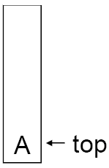
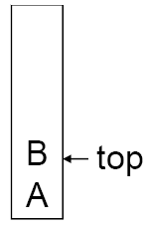
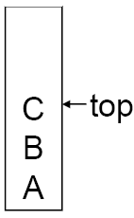
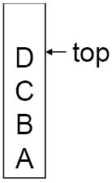
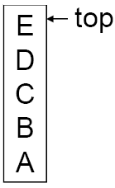
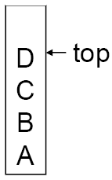
堆疊
Push
  Add an element into a stack
Pop
  Get and delete an element from a stack

Slide 6
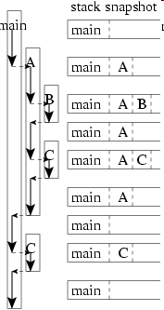
堆疊的應用範例:
系統堆疊 (System Stack)
void B() {
}
void C() {
}
void A() {
B();
C();
}
void main() {
A();
C();
}

Slide 7
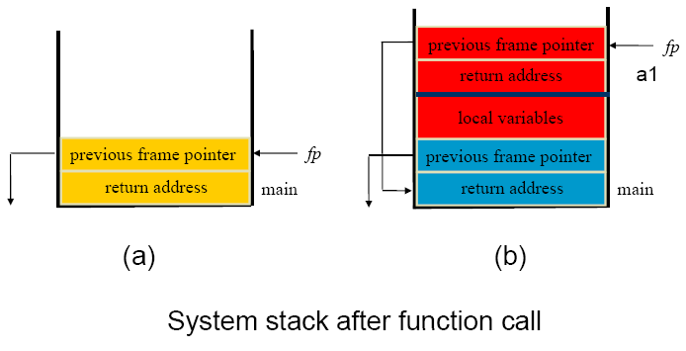
堆疊的應用範例:
系統堆疊 (System Stack)
Stack Frame of Function Call
system stack before a1 is invoked
system stack after a1 is invoked

Slide 8
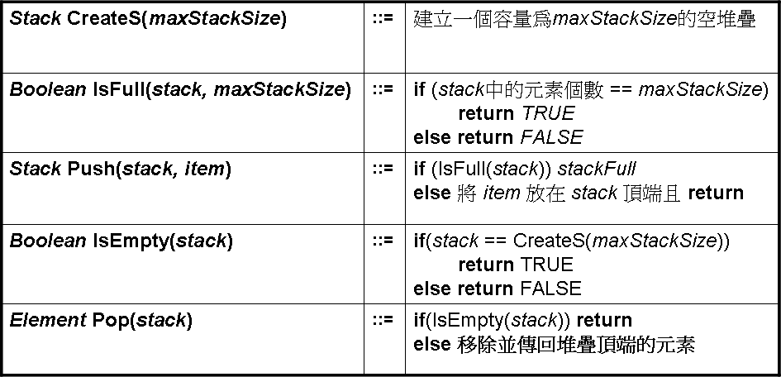
ADT Stack 是
物件:一個含有零個或多個元素的有限有序串列
函式:
對所有 stack ∈ Stack, item ∈ element, maxStackSize ∈ 正整數

Slide 9
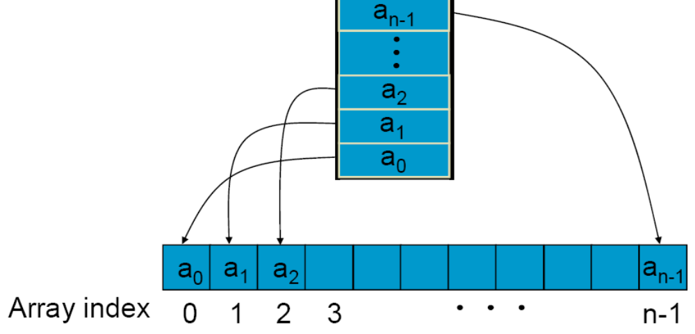
使用陣列來實作堆疊

Slide 10
使用陣列來實作堆疊
Stack CreateS(max_stack_size) ::=
#define MAX_STACK_SIZE 100 /* maximum stack size */
typedef struct {
int key;
/* other fields */
} element;
element stack[MAX_STACK_SIZE];
int top = -1;
Boolean IsEmpty(Stack) ::= top< 0;
Boolean IsFull(Stack) ::= top >= MAX_STACK_SIZE-1;

Slide 11
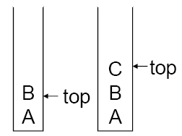
Adding to a Stack
void push (element item)
{
/* 將一個項目加到全域堆疊中 */
if (top >= MAX_STACK_SIZE - 1) {
stackFull( );
stack[ ++top ] = item;
}

Slide 12
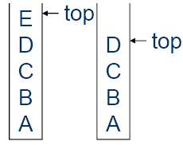
Deleting from a Stack
element pop ()
{
/* 刪除並傳回堆疊的頂端元素 */
if (top == -1)
return stackEmpty( );
/*傳回一個錯誤的索引值 */
return stack[ top --];
}

Slide 13
佇列

Slide 14
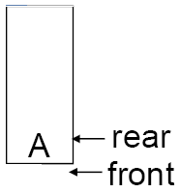
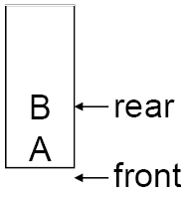
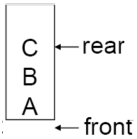
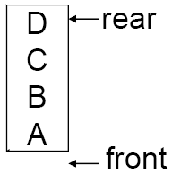
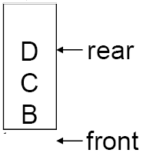
佇列
在序列的同一端移除、放入資料。
  堆疊
在序列的不同端移除、放入資料。
  佇列
  加入新元素的那端稱為後端(rear)
  刪除舊元素的那端稱為前端(front)

Slide 15
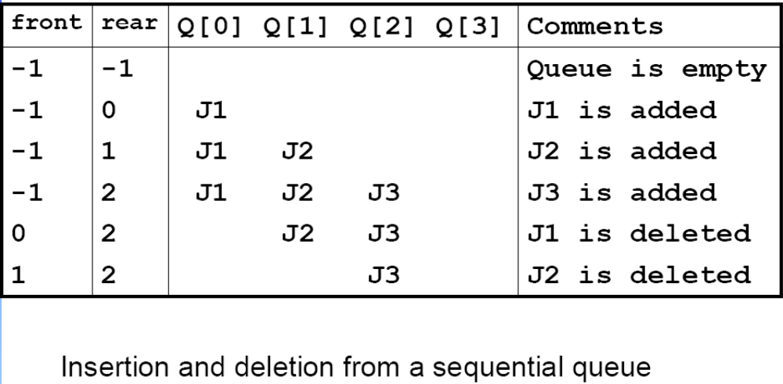
Application: Job Scheduling

Slide 16
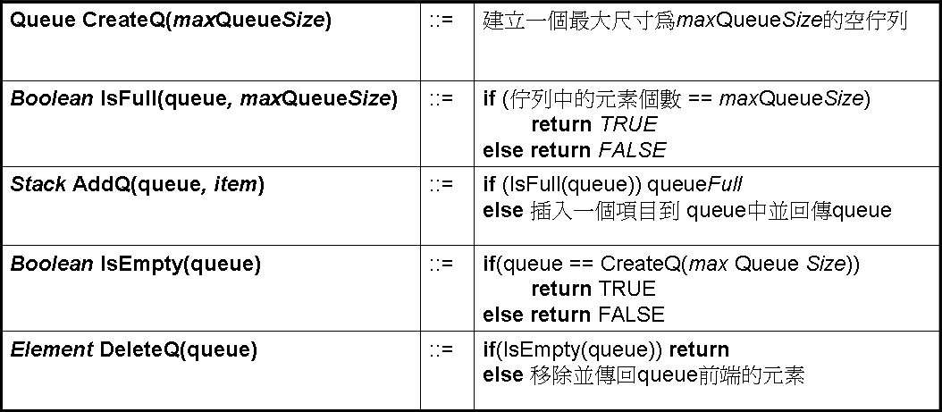
ADT Queue 是
物件:一個含有零個或多個元素的有限有序串列
函式:
對所有 queue ∈ Queue, item ∈ element, maxQueueSize ∈ 正整數

Slide 17
使用陣列來實作佇列
Queue CreateQ(max_queue_size) ::=
# define MAX_QUEUE_SIZE 100/* 最大的佇列尺寸 */
typedef struct {
int key;
/* 其他欄位 */
} element;
element queue[MAX_QUEUE_SIZE];
int rear = -1;
int front = -1;
Boolean IsEmpty(queue) ::= front == rear
Boolean IsFullQ(queue) ::= rear == MAX_QUEUE_SIZE-1

Slide 18
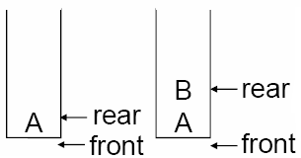
Adding to a Queue
void addq( element item)
{ /*將一個項目加入佇列中*/
if (rear == MAX_QUEUE_SIZE - 1)
queueFull();
queue [++ rear] = item;
}

Slide 19
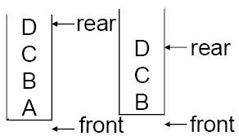
Deleting from a Queue
element deleteq()
{ /*刪除並傳回佇列前端的元素*/
if (front == rear)
return queueEmpty();
return queue [++ front];
}

Slide 20
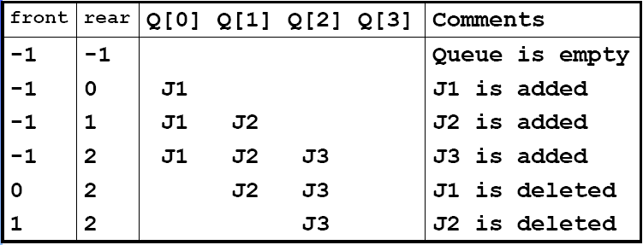
工作排程範例
連續表示法的佇列做插入跟移除

Slide 21
Problem
當工作進入或離開這個系統，佇列匯往右移動。
這代表最後rear的索引值會等於MAX_QUEUE_SIZE – 1，此時佇列會被當成滿的。
此時，queueFull應該把整個queue往左移動，使得第一個元素再回到queue[0]而front的值為-1，rear的值也需要重新計算使他指向對的位置。
平移整個陣列很耗時
  Time Complexity：O(MAX_QUEUE_SIZE)

Slide 22
把陣列視為一個圓圈佇列
Two Indices
  Front: 指向佇列裡第一個元素逆時針方向數來的前一個位置
  Rear: 結尾端
Problem
  判斷一個佇列是否為空或滿的方法
    一個元素空間位置被浪費掉
    最多允許有MAX_QUEUE_SIZE – 1個元素

Slide 23
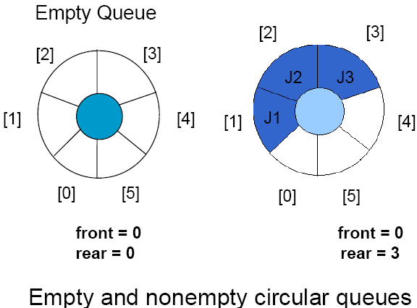
An Example Circular Queue

Slide 24
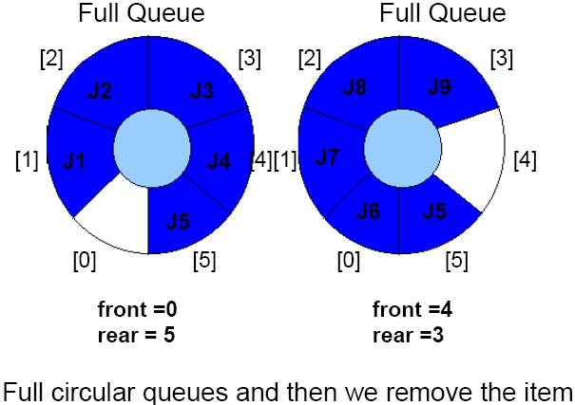
Full Queues

Slide 25
Adding to a Queue
void addq( element item)
{ /* 把項目加入佇列裡 */
rear = (rear +1) % MAX_QUEUE_SIZE;
if (front == rear)
queueFull(); /* 輸出錯誤並離開 */
queue[ rear ] = item;
}

Slide 26
Deleting from a Queue
element deleteq()
{ /*從佇列中移除前面的元素*/
element item;
if ( front == rear)
return queueEmpty( ); /* 傳回錯誤鑰 */
front = (front+1) % MAX_QUEUE_SIZE;
return queue[ front ];
}

Slide 27
迷宮問題

Slide 28
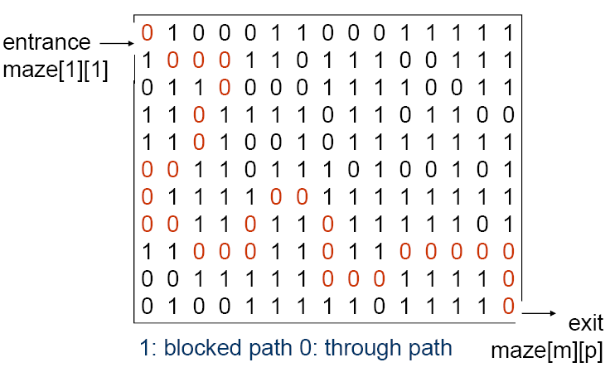
迷宮問題

Slide 29
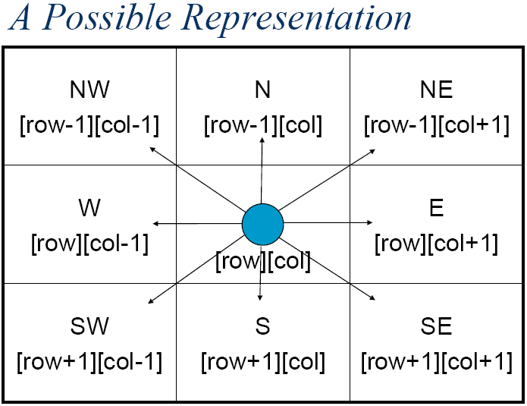

Slide 30

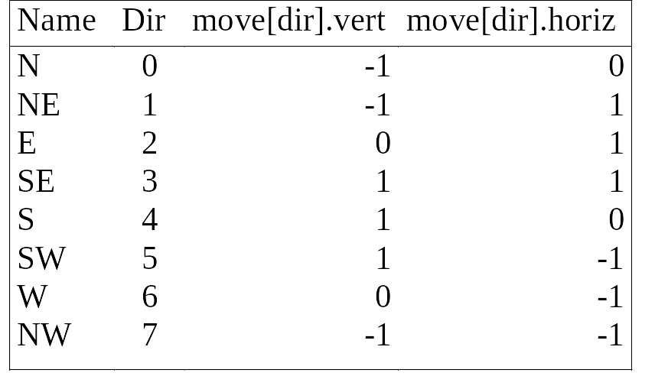
typedef struct {
short int vert;
short int horiz;
} offsets;
offsets move[8]; /*儲存每種移動方向的陣列*/
紀錄走的方向

Slide 31
使用堆疊來保存走過的路徑
What is the maximal size of the stack?
  A maze is represented by a two dimensional array maze[m][p]
  Since each position is visited at most once,at most m ×p elements can be placed in the stack
typedef struct {
short int row;
short int col;
short int dir;
} element;

Slide 32
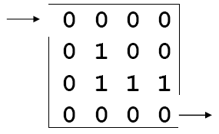
1
2
3
4
0
0
0
0
1
0
0
2
3
(2, 4, 6)
4
(1, 4, 4)
(1, 3, 2)
(1, 2, 2)
(1, 1, 2)
(1, 1, 0)

Slide 33
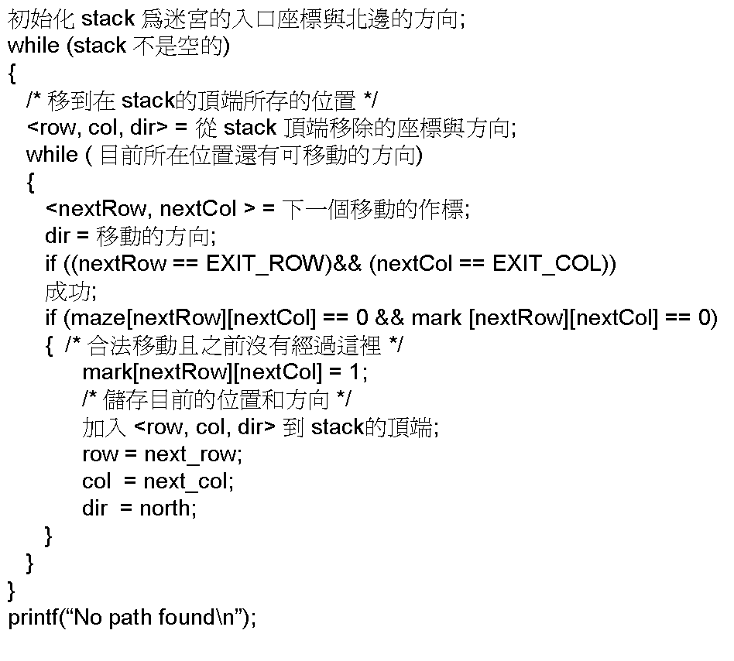

Slide 34
The size of a stack?
000001
111110
100001
011111
100001
111110
100001
011111
100000
m*p

Slide 35
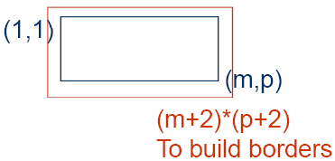
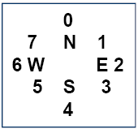
void path (void)
{ /* 輸出迷宮的一個路徑(如果有的話) */ int i, row, col, nextRow, nextCol, dir, found = FALSE; element position; mark[1][1] = 1; top =0; stack[0].row = 1; stack[0].col = 1; stack[0].dir = 1; while (top > -1 && !found) { position = delete(&top); row = position.row; col = position.col; dir = position.dir; while (dir < 8 && !found) {
/*move in direction dir */ nextRow = row + move[dir].vert; nextCol = col + move[dir].horiz;

Slide 36
if (nextRow==EXIT_ROW && nextCol==EXIT_COL) found = true; else if ( !maze[nextRow][nextCol] &&
!mark[nextRow][nextCol] { mark[nextRow][nextCol] = 1; position.row = row; position.col = col; position.dir = ++dir; push(position); row = nextRow; col = nextCol; dir = 0;
} else ++dir;
}
}

Slide 37
if (found) { printf(“The path is :\n”); printf(“row col\n”); for (i = 0; i <= top; i++) printf(“ %2d%5d”, stack[i].row, stack[i].col); printf(“%2d%5d\n”, row, col); printf(“%2d%5d\n”, EXIT_ROW, EXIT_COL);
} else printf(“The maze does not have a path\n”);
}

Slide 38
運算式的計算

Slide 39
Evaluation of Expression
X = a / b - c + d * e - a * c
a = 4, b = c = 2, d = e = 3
Interpretation 1:
  ((4/2)-2)+(3*3)-(4*2)=0 + 9 – 8=1
Interpretation 2:
How to generate the machine instructions
  (4/(2-2+3))*(3-4)*2=(4/3)*(-1)*2= -2.66666…
How to generate the machine instructions? corresponding to a given expression?
  Precedence rule + associative rule

Slide 40
Evaluation of Expression
Infix (中置)
  Each operator comes in-between the operands
  2+3
Postfix (後置)
  Each operator appears after its operands
  23+
Prefix (前置)
  Each operator appears before its operands
  +23

Slide 41
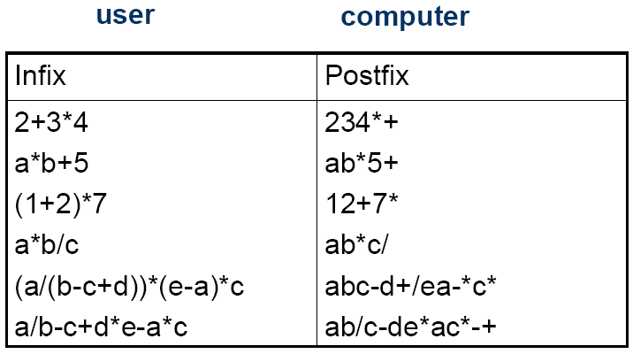
Evaluation of Expression

Slide 42
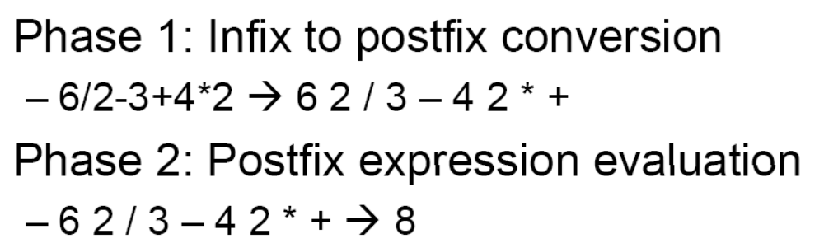
Evaluation of Expression

Slide 43

Phase 2:
Postfix Expression Evaluation
=
3
=
0
=
8
=
8

Slide 44
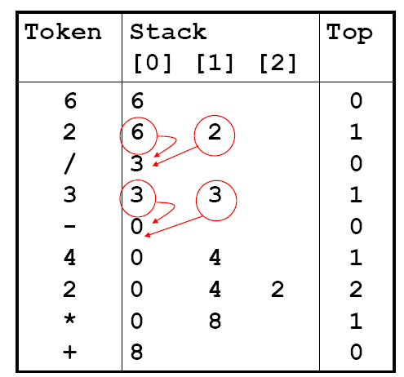
Phase 2:
Postfix Expression Evaluation

Slide 45
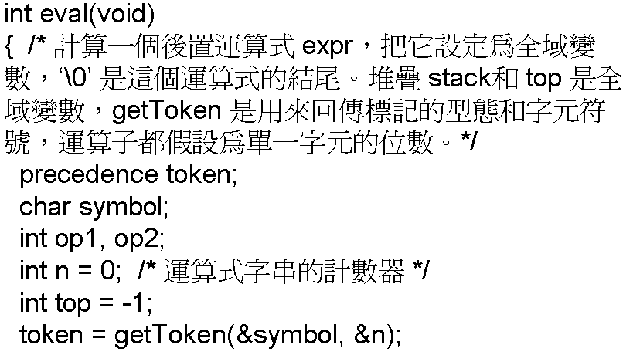

Slide 46
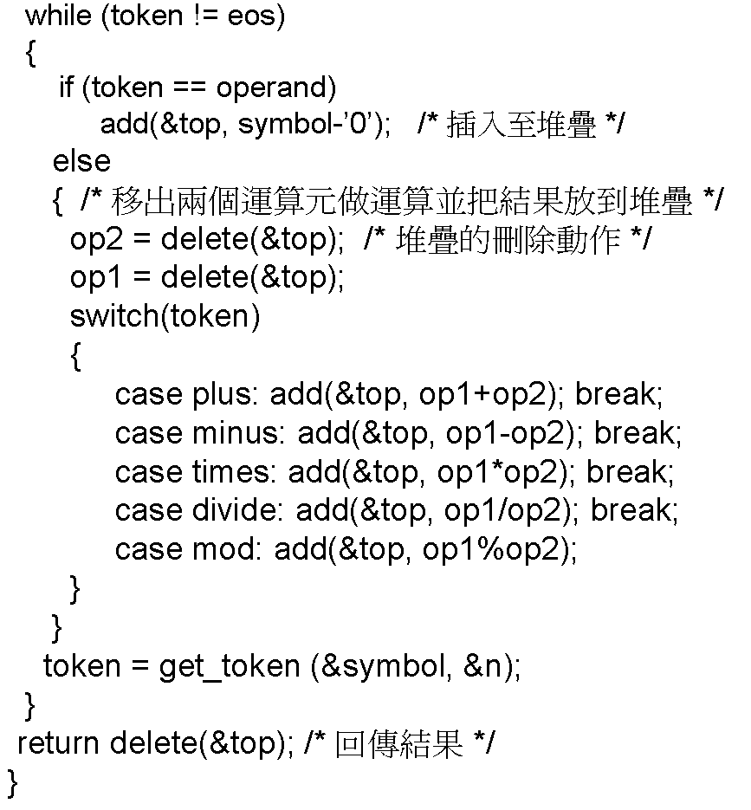

Slide 47
precedence getToken(char *symbol, int *n)
{ /* 拿下一個標記，symbol 是用字元的表示，會被回傳。標記是用它的列舉的值來表示，會被這函式回傳 。*/
*symbol = expr[(*n)++]; switch (*symbol)
{ case ‘(‘ : return lparen; case ’)’ : return rparen; case ‘+’: return plus; case ‘-’ : return minus; case ‘/’ : return divide; case ‘*’ : return times; case ‘%’ : return mod; case ‘\0‘ : return eos; default : return operand; /* 不做錯誤檢查，預設為數字 */
}
}

Slide 48
Phase 1:
Infix to Postfix Conversion
Assumptions:
  operators: +, -, *, /, %
  operands: single digit integer
直覺式方法
  1.把運算式加上完整的括號。
  2.把所有的二元運算子移到相對應的右括號後。
  3.去除所有括號。

Slide 49
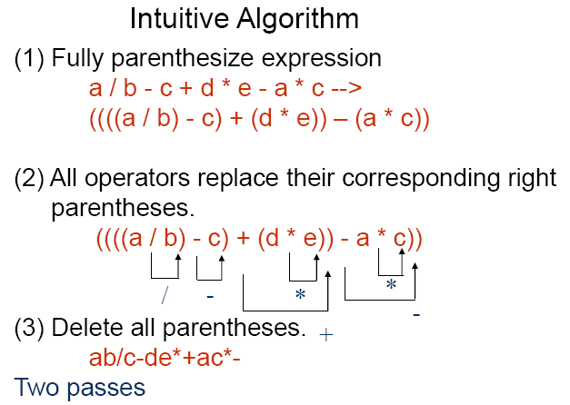
需兩次轉換，所以效率不好。
由於中置運算式與後置運算式的運算元順序一樣，可藉由從左到右掃描中置運算式來產生等價的後置運算式。在掃描的過程中，當運算元被碰到時直接輸出。而運算子輸出的順序會跟其運算優先權有關。既然必須先輸出較高優先權的運算子，我們可以先儲存運算子，直到知道正確的放法。

Slide 50

The orders of operands in infix and postfix are the same.

Slide 51
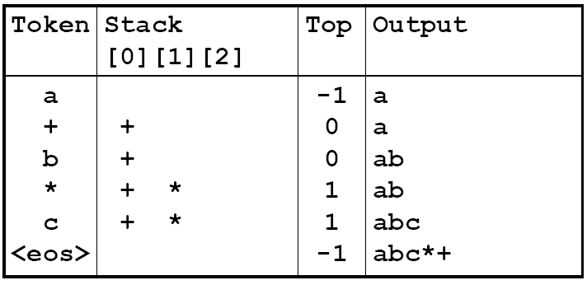
The orders of operands in infix and postfix are the same.
有較高優先權的運算子一定要比較低優先權的先輸出。因此，只要堆疊頂端的運算子優先權比新進來的運算子低，我們就繼續把運算子放到堆疊中。

Slide 52
The orders of operands in infix and postfix are the same.
有較高優先權的運算子一定要比較低優先權的先輸出。因此，只要堆疊頂端的運算子優先權比新進來的運算子低，我們就繼續把運算子放到堆疊中。

Slide 53

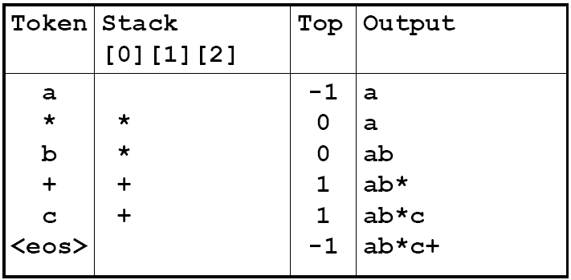
The orders of operands in infix and postfix are the same.

Slide 54

我們把運算子一直留在堆疊中直到我們碰到右括號。這時我們就從堆疊中移除。然後我們就把左括號從堆疊中移除。

Slide 55
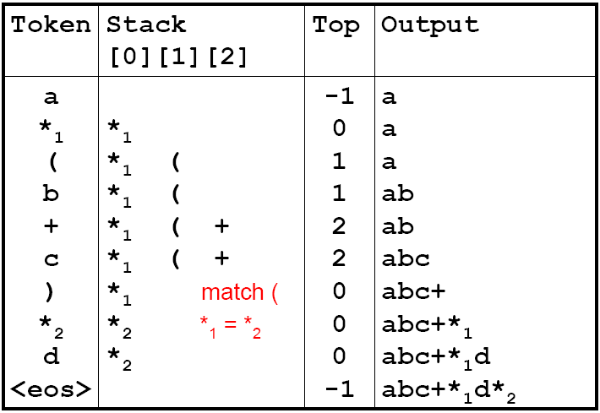
我們把運算子一直留在堆疊中直到我們碰到右括號。這時我們就從堆疊中移除，直到我們碰到左括號為止。然後我們就把左括號從堆疊中移除。

Slide 56

Rules
Operators are taken out of the stack as long as their in-stack precedence is higher than or equal to the incoming precedence of the new operator.
  isp(y) >= icp(x)
“(” has low in-stack precedence, and high incoming precedence.
  No operator other than the matching right parenthesis “)” should cause it to get unstacked

Slide 57
precedence stack[MAX_STACK_SIZE];
/* isp and icp arrays -- index is value of precedence
lparen, rparen, plus, minus, times, divide, mod, eos */
static int isp [ ] = {0, 19, 12, 12, 13, 13, 13, 0};
static int icp [ ] = {20, 19, 12, 12, 13, 13, 13, 0};
isp: in-stack precedence
icp: incoming precedence

Slide 58
void postfix(void)
{ /* 輸出運算式的後置表示。運算式的字串、stack，以及 top 都是全域變數。*/ char symbol; precedence token; int n = 0; int top = 0; /* 放 eos 在堆疊上 */ stack[0] = eos; for (token = getToken(&symbol, &n); token != eos; token = getToken(&symbol, &n)) { if (token == operand) printf (“%c”, symbol); else if (token == rparen ){
/* 從堆疊中移出符號直到出現左括號 */

Slide 59
while (stack[top] != lparen) printToken(pop()); pop(); /*把左括號移掉 */
} else{
/* 移除並印出 isp 值大於或等於現在標記 icp 的標記*/ while(isp[stack[top]] >= icp[token] ) printToken(pop()); push(token);
}
} while ((token = pop() != eos) printToken(token); print(“\n”);
}

Slide 60
多重堆疊和佇列

Slide 61
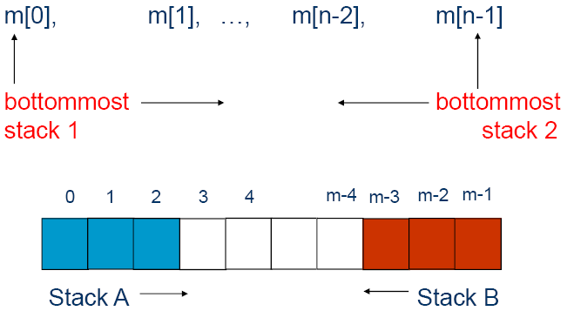
Two stacks

Slide 62
Multiple Stacks and Queues
More than two stacks (n)
Memory is divided into n segments
  The initial division of these segments may be done in proportion to expected sizes of these stacks if these are known
  All stacks are empty and divided into roughly equal segments

Slide 63
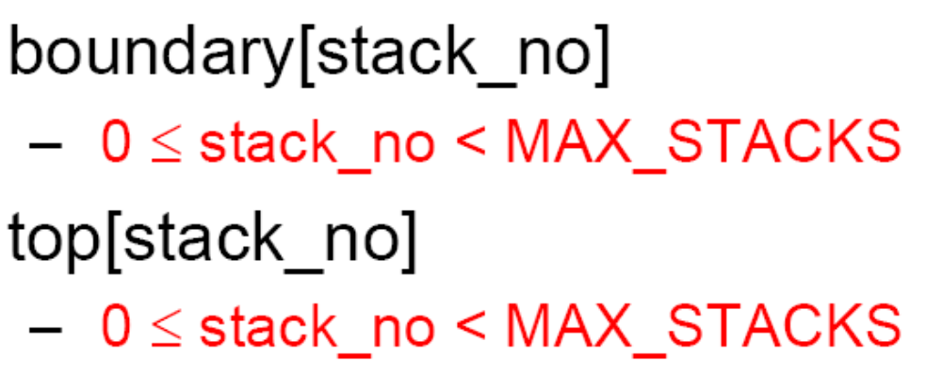
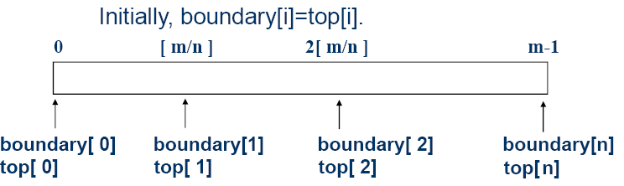
Multiple Stacks and Queues
All stacks are empty and divided into roughly equal segments.

Slide 64
#define MEMORY_SIZE 100 /* 記憶體的大小 */
#define MAX_STACK_SIZE 100 /* 堆疊的最大數量加一 */
/* 全域的記憶體宣告*/
element memory[MEMORY_SIZE];
int top[MAX_STACKS];
int boundary[MAX_STACKS];
int n; /* 由使用者輸入堆疊數量 */
top[0] = boundary[0] = -1;
for (j = 1; j < n; j++)
top[j] =boundary[j] =(MEMORY_SIZE/n)*j;
boundary[n] = MEMORY_SIZE-1;

Slide 65
void push(int i, element item)
{
/* 把一個項目加到第i個堆疊 */
if (top[i] == boundary [i+1])
stackFull(i); //may have unused storage
memory[++top[i]] = item;
}
element pop(int i)
{
/* 把第i個堆疊頂端的元素刪除 */
if (top[i] == boundary[i])
return stackEmpty(i);
return memory[top[i]--];
}

Slide 66
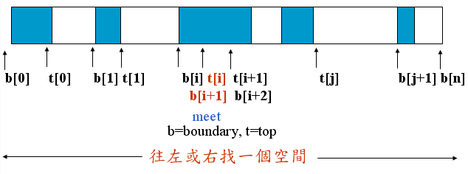

Slide 67


Slide 68
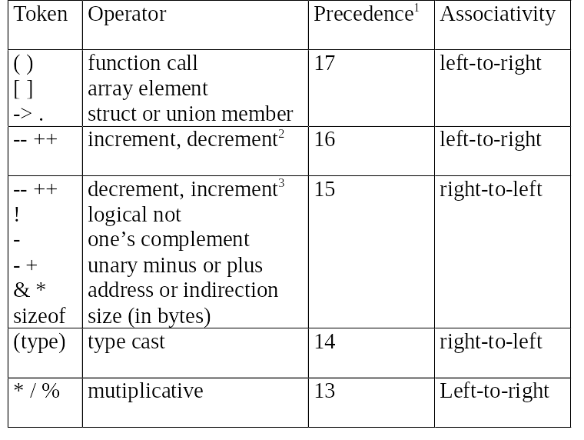
C的運算子優先權順序

Slide 69
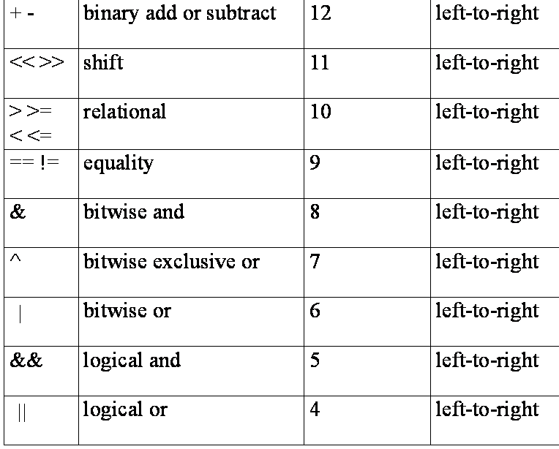
C的運算子優先權順序

Slide 70
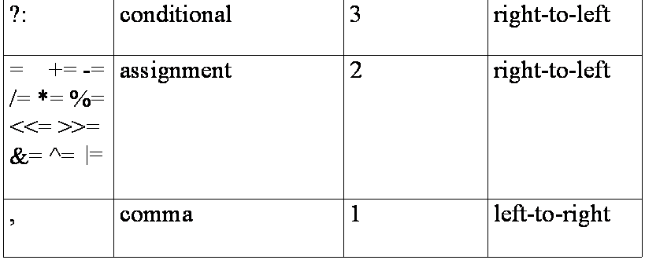
C的運算子優先權順序

